Slide 1
Music Player
Eshwar Kanikanti

Slide 2
Project Overview
Purpose: to listen and have access to music without internet connection
Alternative to Spotify and YouTube music which require internet access
Useful in situations where you don’t have access to the internet, such as traveling by plane
Users can play and pause songs, skip songs, and go back to the previous song with the click of a button
Admins can change the layout of the music player, add or remove songs, and change album covers

Slide 3
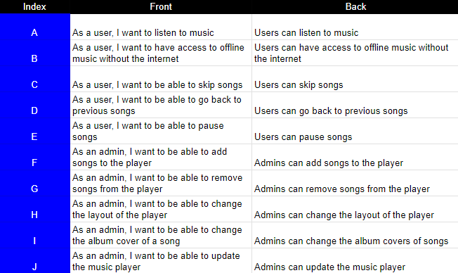
User stories

Slide 4

Features
Play/pause button
Next and previous button
Song slider
Current time and song duration
Spinning disk
Cover photo
Song name and artist name

Slide 5

Challenges
Deciding the idea for the project
Creating the play/pause symbols
Creating the forward and backward symbols
Getting the cover photo to show for each song
Matching the slider with the current song time
Formatting the current time and song duration
Finding songs to use for the music player

Slide 6
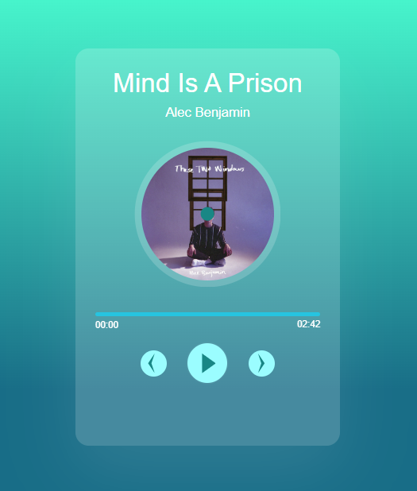
Project Showcase

Slide 7
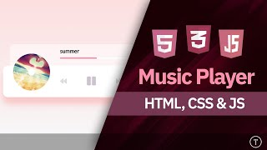
Sources

